Slide 1
Lower granite master plan revision
Public Scoping Meeting
Clarkston, WA - March 22, 2017
Pullman, WA - March 23, 2017
Jason Achziger
Lower Granite Natural Resources Manager
Chris Alford
Senior Natural Resources Specialist
Notes:
Hello. My name is Chris Alford and I am the Walla Walla District Senior Natural Resources Specialist. I am also coordinating this public scoping effort.
Thank you for taking the time to come to this meeting. Your input will help us shape this revision and we cant do it without your help. 15 minute presentation, After presentation, we will leave this area and head over to the display boards and comment stations.
then the remainder of the time can be spent reviewing the display boards where there will be time to speak to subject matter experts at the display boards in the other room directly following this presentation. So please hold your questions or comments until that time.

Slide 2
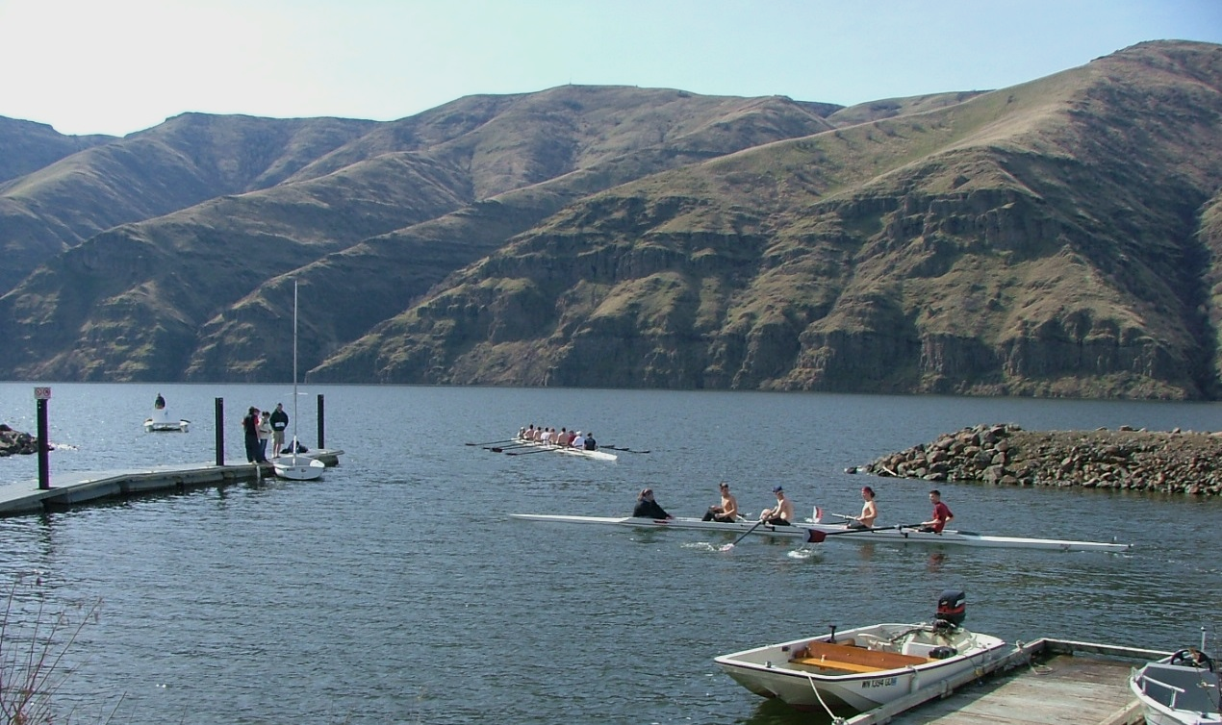
Agenda
Project Area
Value to the Region
What is a Master Plan?
Why Revise The Master Plan?
Primary Components of a Master Plan
Revision Process and Public Involvement

Slide 3
Project area map
Notes:
General project area. We are looking at the lands managed by the Corps of Engineers from just below Lower Granite Dam, up the Snake to just above Asotin and up the Clearwater to Hog Island near the US 95 bridge. Key factor is we are talking about the land management, not dam operations.
Does not include Illia

Slide 4
Value to the Region
Approximately 20 miles of multi-purpose ADA-accessible trails recognized nationally by the National Recreation Trails Program.
Provides more than 7,000 acres of public
land available for wildlife viewing,
hunting and fishing.
Estimated 1.8 million visits in 2012.
Notes:
Clearwater and Snake River National Recreational Trail
Visitors commonly purchase from local businesses adding to local revenue

Slide 5
What is a master plan?
A document that:
Describes how the natural and recreational resources of the lands will be managed.
Provides a vision for how the lands should look in the future.
Main focus is stewardship of natural and cultural resources and provision of high-quality outdoor recreation facilities and opportunities.
Proposed effective life of a Master Plan is 20 years.
Notes:
Our current MP was finalized in 1974 – over 40 years ago. So it is time for a revision.

Slide 6
Why Revise Lower Granite’s Master Plan?
Existing Master Plan was completed in 1974 and has exceeded its useful life.
The 1974 Master Plan focused on initial recreation facilities development and less on natural resources, fish wildlife, and environmentally sensitive areas.
Original land classifications do not meet current Corps regulations.
Sustainably manage the lake’s resources for future generations.
Respond to changing land use.
Notes:
Hydropower and Navigation (1945 Rivers and Harbors Act)
Other Purposes
ES – Lands, Fish, and Wildlife
Recreation

Slide 7
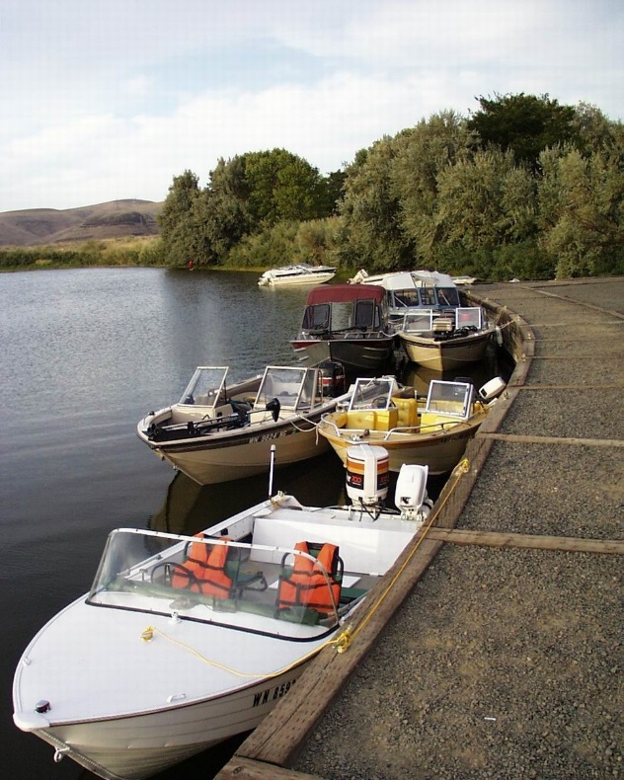
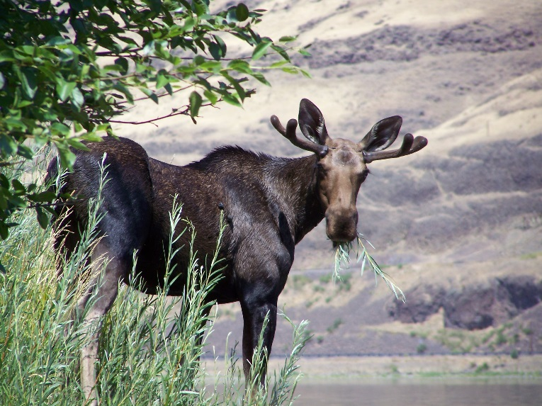
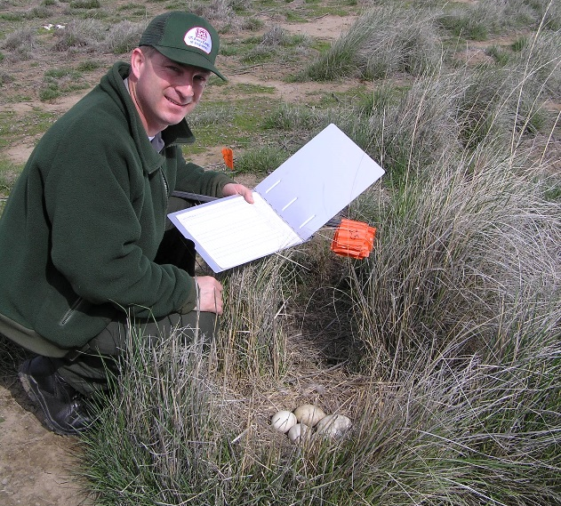
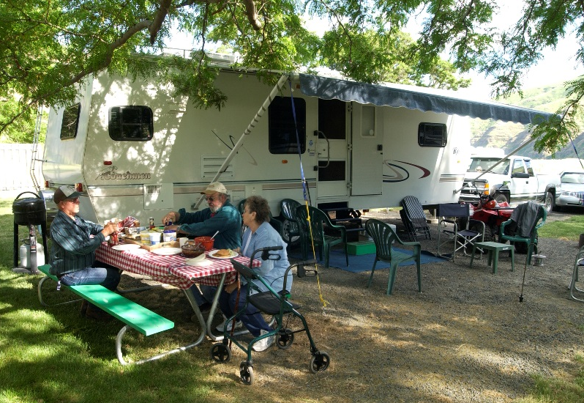
What Major Changes are Needed in the Current Master Plan?
Reclassify all project lands
Prepare new Resource Objectives
Prepare new Resource Plan
Notes:
Reclassify all project lands
ER 1130-2-550 provides new land classification system that all revised Master Plans must follow.
Prepare new Resource Objectives
Need current recreation objectives that reflect major trends.
Need current natural resources objectives that reflect major habitat and vegetation needs.
Prepare new Resource Plan
1974 Master Plan identified initial developments on project lands.
Resource plan must be revised to reflect current management areas and future conceptual development plans.

Slide 8
Primary Components of a Master Plan
Resource Objectives – Clearly written statements that set forth measureable and attainable current and future management and development activities that support the goals of the MP
Land Classifications – The primary use for which the project lands are managed. Lands are zoned for development and resource management consistent with authorized project purposes
Notes:
Examples of Resource Objectives:
Boundary management
Safety
Wildlife habitat management
Weed management
Resource Objectives fit with the Land Classification. Our focus is to ensure the land is classified correctly and then develop resource objectives from there.

Slide 9
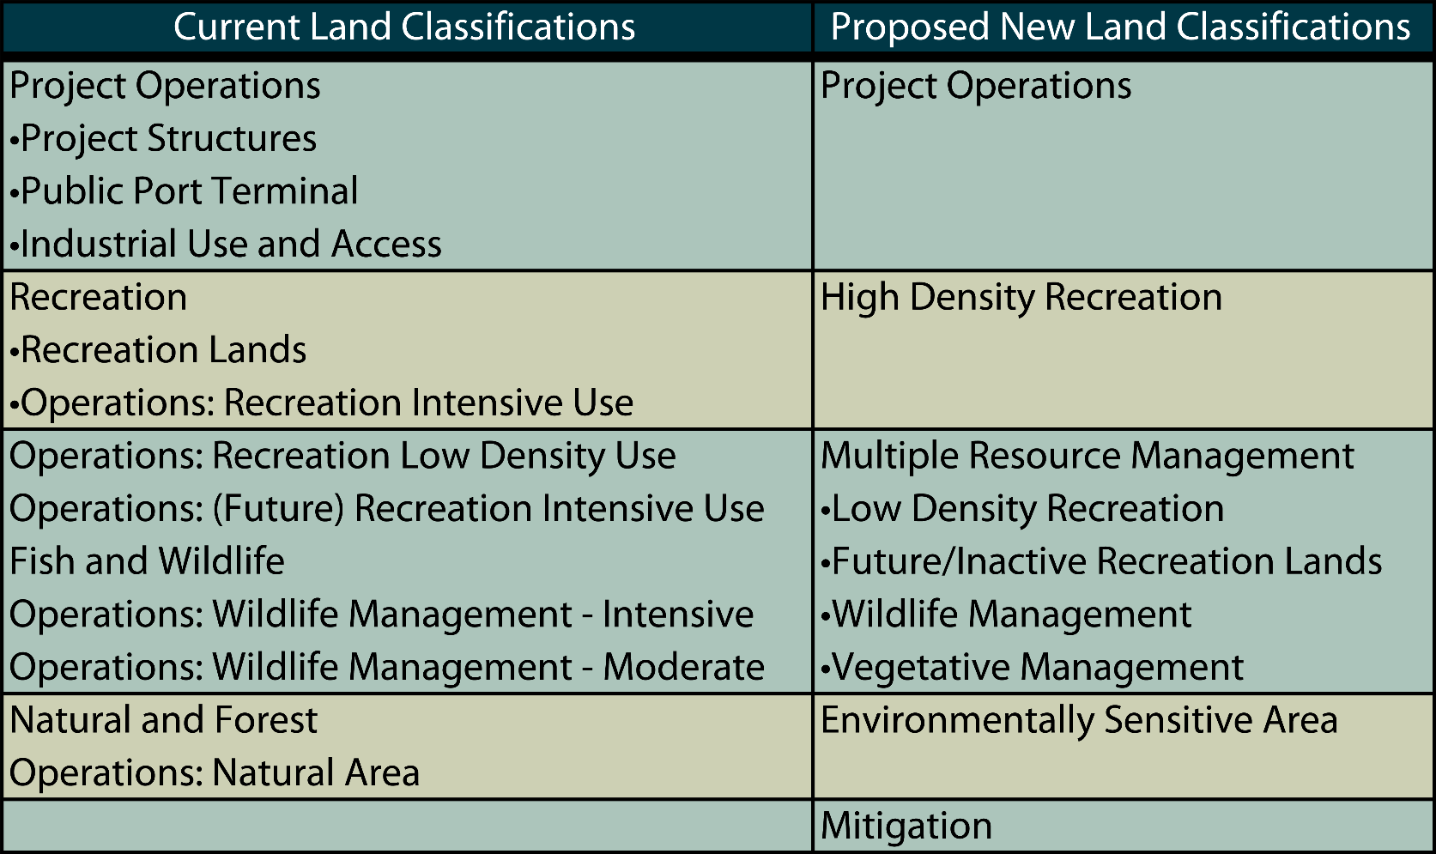
Lower Granite Land Classification Current and Proposed

Slide 10
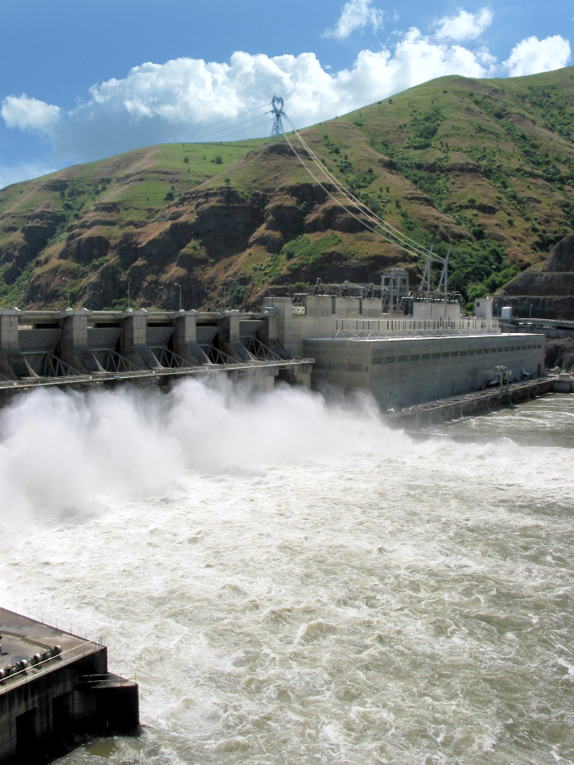
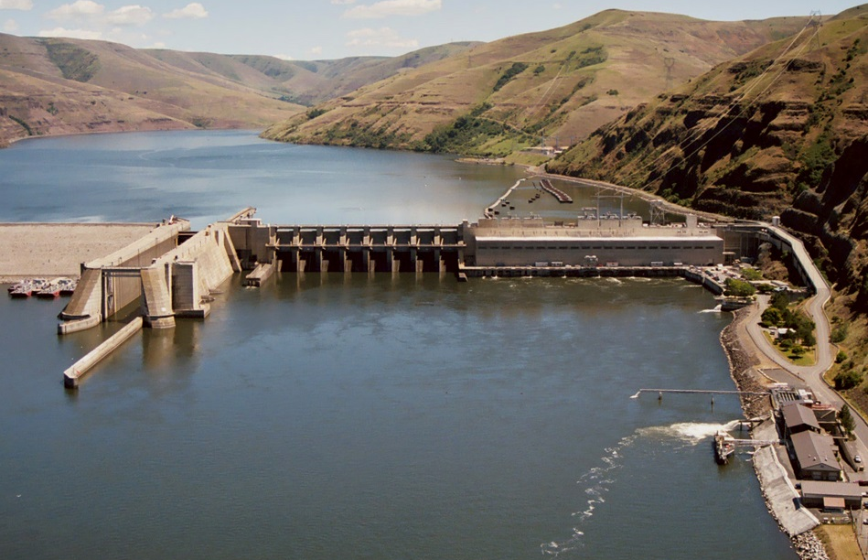
Land Classifications
Operations – This classification category should include those lands required for the dam. spillway, switchyard, offices, maintenance facilities, and other areas that are used solely for project operations.

Slide 11
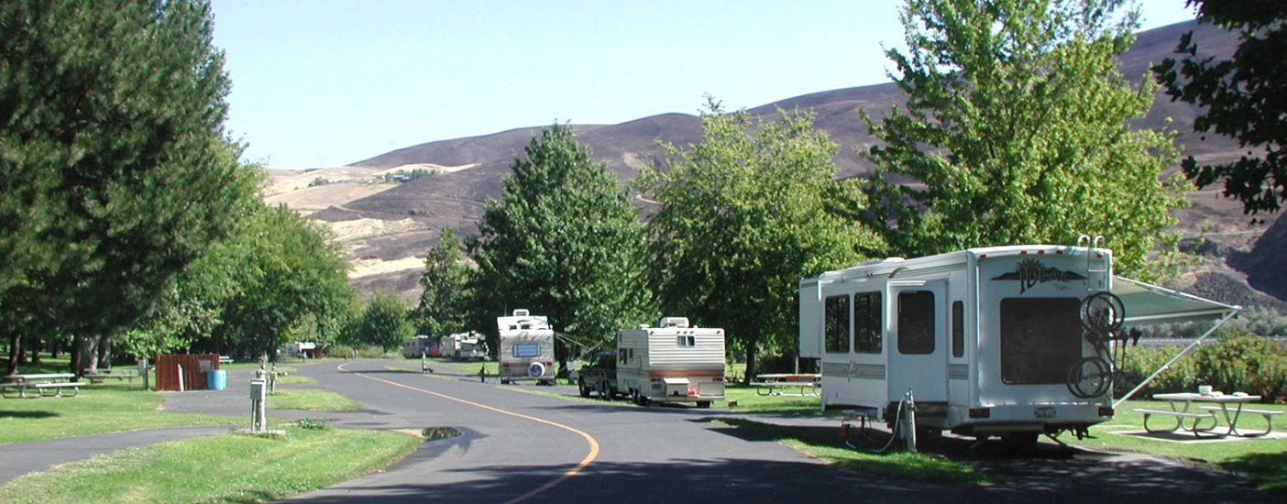
Land Classifications
High-Density Recreation
– Land developed for intensive
recreational activities by the
visiting public, including developed
recreation areas and locations for
concessions, resorts, marinas, etc.
Notes:
Swallows Park, Chestnut Beach, Chief Timothy Park

Slide 12
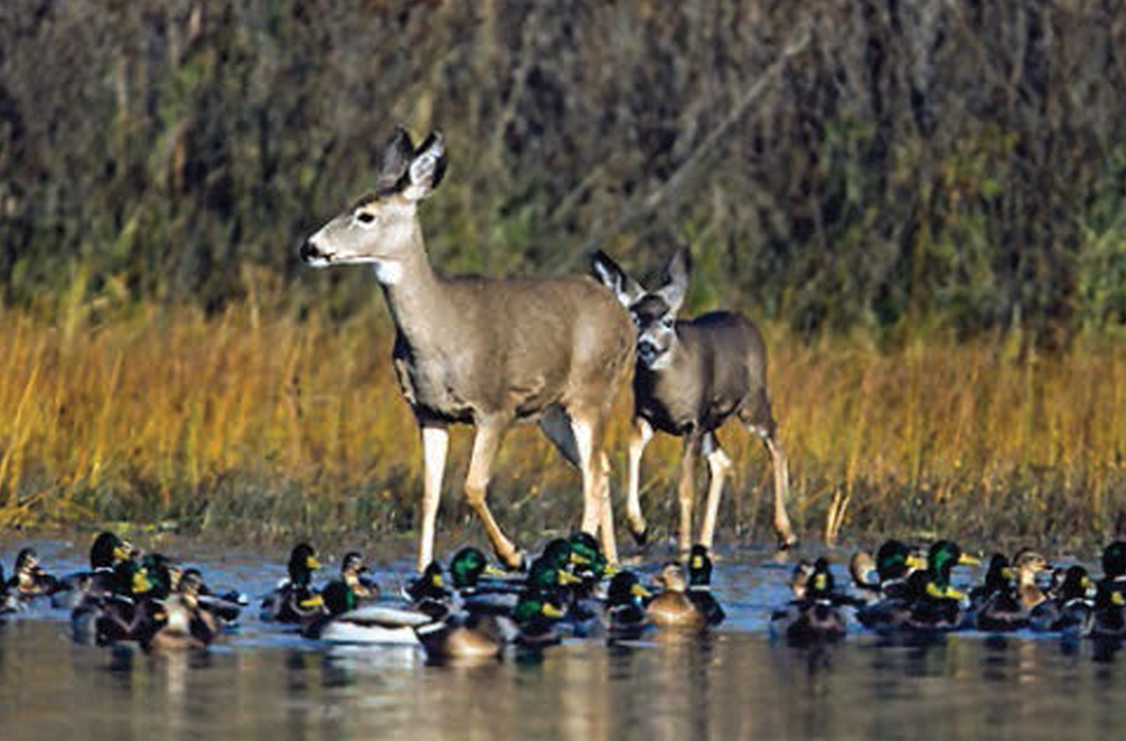
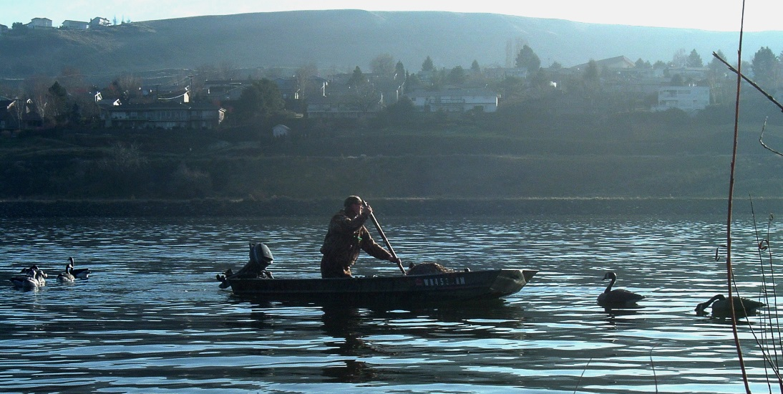
Land Classifications
Mitigation – This will only include land acquired or designated specifically for mitigation.
Notes:
Lower Snake River Comp Plan (HMUs)

Slide 13
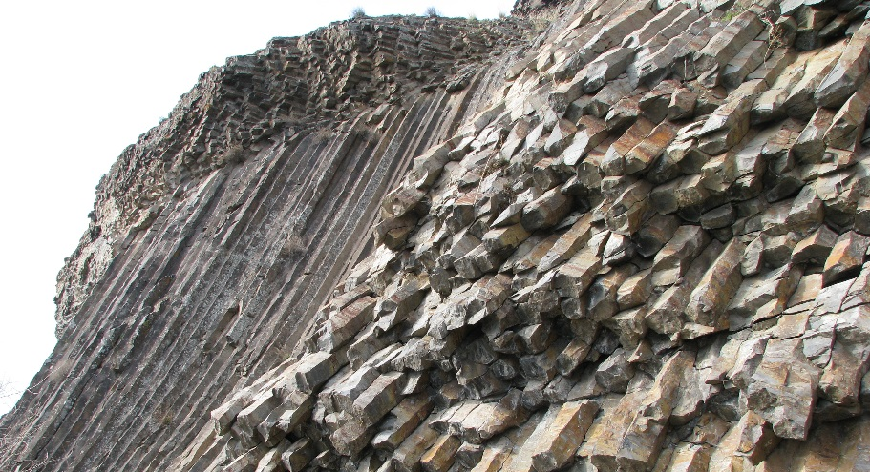
Land Classifications
Environmentally Sensitive Areas
– These are areas where scientific,
ecological, cultural or aesthetic features
have been identified. These areas
must be considered by management
to ensure the sensitive areas are not
adversely impacted.
Notes:
Designation of these lands is not limited to just lands that are otherwise protected by laws such as the Endangered Species Act, the National Historic Preservation Act or applicable State statutes.
Examples may include mature bottomland forests, river and stream corridors, scenic bluffs and bluffs, native prairie.

Slide 14
Land Classifications
Multiple Resource Management: Recreation Low-Density – Lands with minimal development or infrastructure that support passive public recreation use (e.g. hiking, primitive camping, wildlife observation, hunting, fishing, trails, wildlife viewing, etc.).

Slide 15
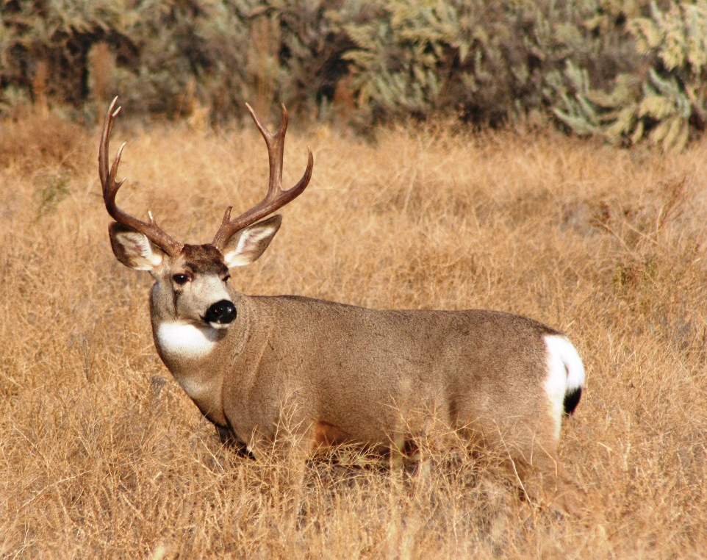
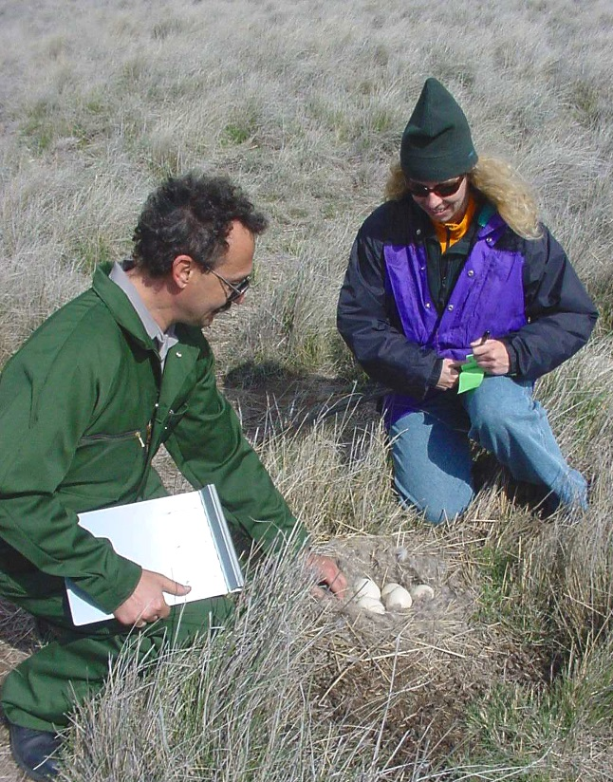
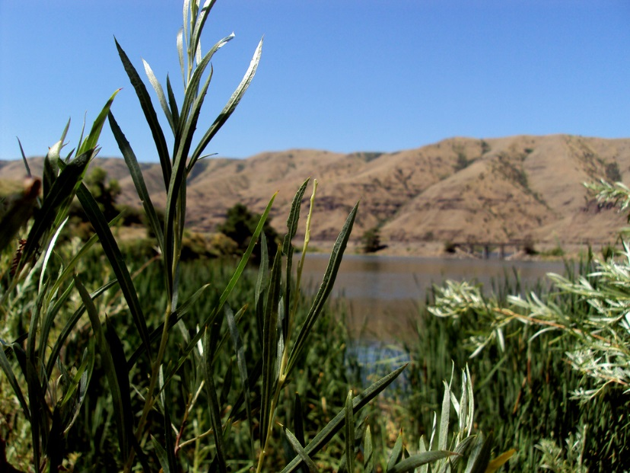
Land Classifications
Multiple Resource Management: Wildlife Management – Lands designated for the
stewardship of fish and
wildlife resources.

Slide 16
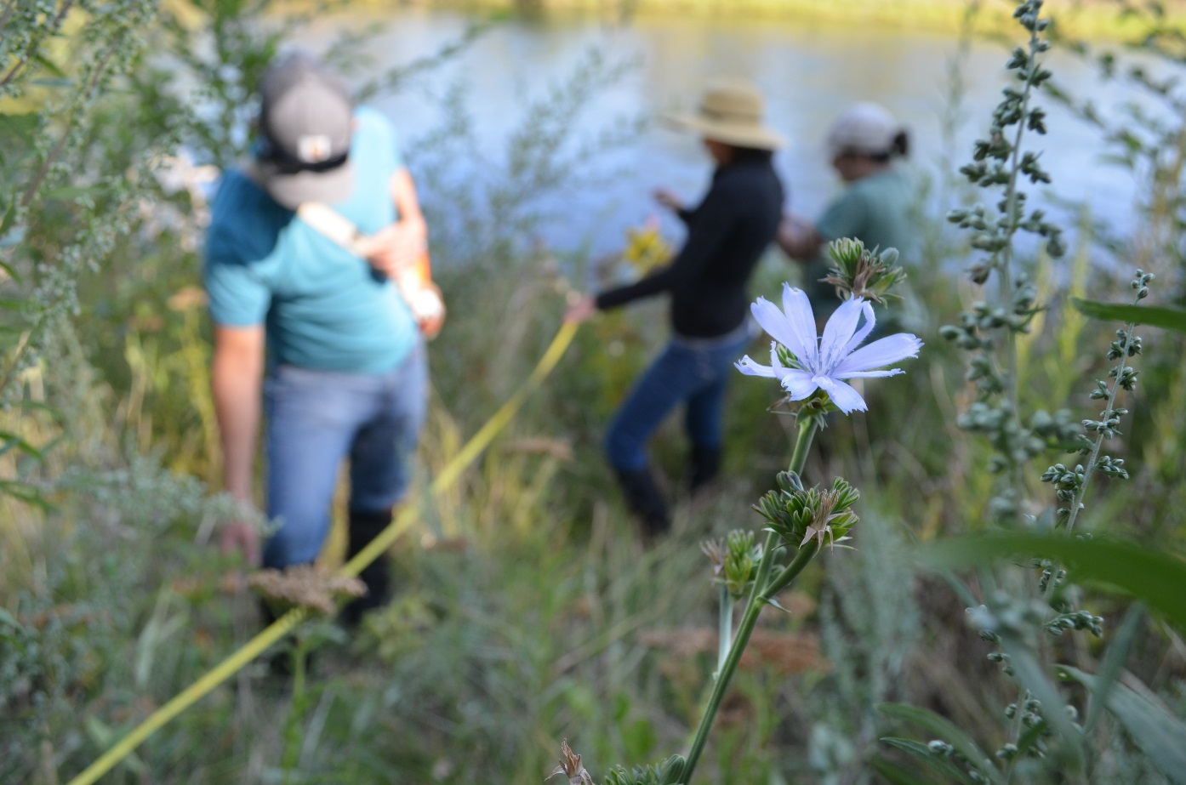
Land Classifications
Multiple Resource Management: Vegetative Management – Lands designated for stewardship and management activities for the protection and development of forest and vegetative cover.

Slide 17
Land Classifications
Multiple Resource Management:
Inactive and/or Future
Recreation Areas
– Recreation areas planned for
the future or that have been
temporarily closed. These lands
will be classified as multiple
resource management in the interim.
Reserved
for
Recreation
Notes:
End of Land Classification descriptions and now we will look at the process, timeline, and comment procedures

Slide 18
Revision Process and Timeline
How can you help:
Please, provide your comments on how you would like to see the natural and recreational resources at Lower Granite managed in the future.
Public input will be collected through these means:
At this meeting
USPS or email
Master Plan website
What happens with your input?
Comment period is open March 22 to April 22, 2017.
Corps will consider all comments regarding the Lower Granite Master Plan.

Slide 19
U.S. Postal service: USACE-Walla Walla District CENWW-OD-T Lower Granite MP 201 N 3rd Ave Walla Walla, WA 99362 Email: lowergraniteMP@usace.army.mil Website: www.nww.usace.army.mil Click on Lower Granite Master Plan under Current Projects
QUESTIONS AND COMMENTS

Slide 20
Project area map
Notes:
Open house format in the other room. Make sure you enter your comments submitted. At this meeting, use one of the six computers, explain your comment to one of our employees at the maps, or fill out a comment card. At a later time, enter comment online, email a comment, or r fill out the comment form at a later date.
Thank you for taking the time to participate in our scoping process.

